Slide 1

Attrrition Analysis Project
Presented by-Soumya Ranjan Sethi
Mentor-Shilesh

Slide 2
Data Analysis
Business plan-To predict the attrition rate.
Business Solution-Binomial Logistic Regression.
5 variables and 50 observations.
Dependent Variables-
Retain_Indicator(Binary :0-Employee retained,1-Employee Left)
Independent Variables-
sex_indicator (Binary:0-Male,1-Female)
Relocation_indicator (Binary:0-Resign due to Relocation,1-Resign not related to Relocation)
Marital_status (Binary:0-Married,1-Unmarried)
Employee_id:(Unique Variable)

Slide 3
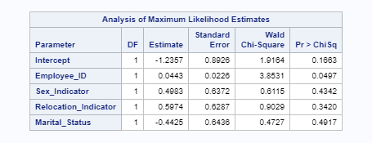
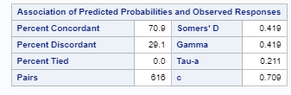
Model Interpretation-
1)Looking at the table Employee_ID-P value is 0.0497 so it is Significant.
2) As P value is less then 0.05 so the slope of the employee_id is-0.0443
3)Establish the relationship between dep Var and Sig Indep Var (For 1unit change of the Employee_id the log odd of retention vs non-retention increases by 0.443) It signifies that the probabality of retention increases with the increase of employee_id
4)C statistic in this model is 0.709 that is >=70 So that’s shows the quality of the model is Good

Slide 4
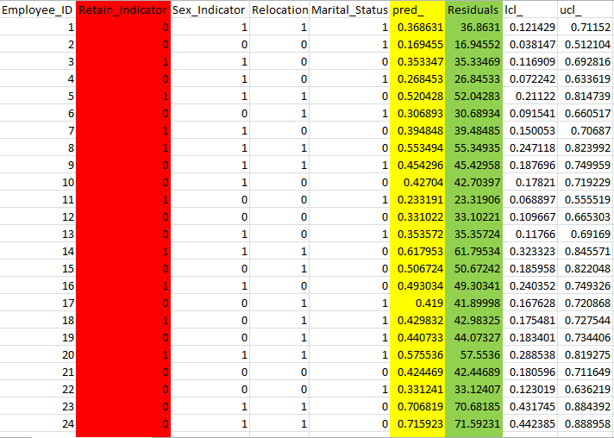
Conclusion-
The model suggests that the new joiners tend to leave the company more often as compared to the old joiners.
It can be suggested that the BPO should run some training programmers which target to the new joiners to keep them attached to the organization.

